Slide 1



IECS 2026
FIRST IEEE INTERNATIONAL CONFERENCE ON
INTELLIGENT ELECTRONICS & COMPUTATIONAL SYSTEM
Classification of Glaucoma Stages Using Image Empirical Mode
Decomposition and an Ensemble Learning Framework from Retinal Fundus Images
Zoya Ejaz • Varni Kumar Patel • Ajay Sharma • Praveen Kumar Tyagi • Devendra Kumar Bajpai
Paper ID: 2356
VIT BHOPAL UNIVERSITY, INDIA

Slide 2
IECS 2026
Index
Introduction
Literature Review
Methodology
Dataset
Preprocessing
Multi-Source Feature Extraction
Image Empirical Mode Decomposition (IEMD)
Feature Selection & Dimensionality Reduction
Model Evaluation
Output
Results
Conclusion
References
VIT BHOPAL UNIVERSITY, INDIA

Slide 3
IECS 2026
Introduction
Glaucoma is a progressive disease of the optic nerve, usually linked to increased pressure inside the eye (IOP).Second leading cause of vision loss worldwide.
It affects an estimated 80 million people worldwide and is the second leading cause of blindness globally.
Unlike cataracts, once glaucoma damages the optic nerve, the vision loss is permanent and irreversible.
Early detection is the only real solution, this makes automated, accessible screening tools critical, especially in areas with limited access to eye specialists.
Conventional tests (tonometry, ophthalmoscopy, perimetry) are effective but time-consuming, skill-dependent and hard to scale in resource-poor regions.
Retinal fundus photography offers a non-invasive, low-cost, and accessible alternative — well suited to automated analysis.
2
VIT BHOPAL UNIVERSITY, INDIA

Slide 4
IECS 2026
Literature Review
Automated fundus-based glaucoma detection has evolved from global frequency-domain features to deep learning and hybrid decomposition methods.
Author(s) | Method | Limitation
Nayak et al. [1] | Artificial Neural Network (ANN) on handcrafted fundus features | Basic ANN on handcrafted features; no ensemble or multi-fold robustness validation
Acharya et al. [2] | Gabor transform descriptors + Least-Squares SVM (LS-SVM) | Single feature type (Gabor only) and single classifier; limited texture information, no multi-source features
Maheshwari et al. [3] | Empirical Wavelet Transform (EWT) + classification | Only 80.66% accuracy; EWT uses a fixed, predetermined wavelet basis — not adaptive to individual image structure
Yi et al. [4] | MTRA-CNN (deep learning, multi-scale transfer learning) | Needs large labeled data and heavy computation; less interpretable ("black box"); harder to deploy in low-resource clinical settings
Research gap: ensemble learning combined with Image Empirical Mode Decomposition (IEMD) remains largely unexplored on public benchmarks.
2
VIT BHOPAL UNIVERSITY, INDIA

Slide 5
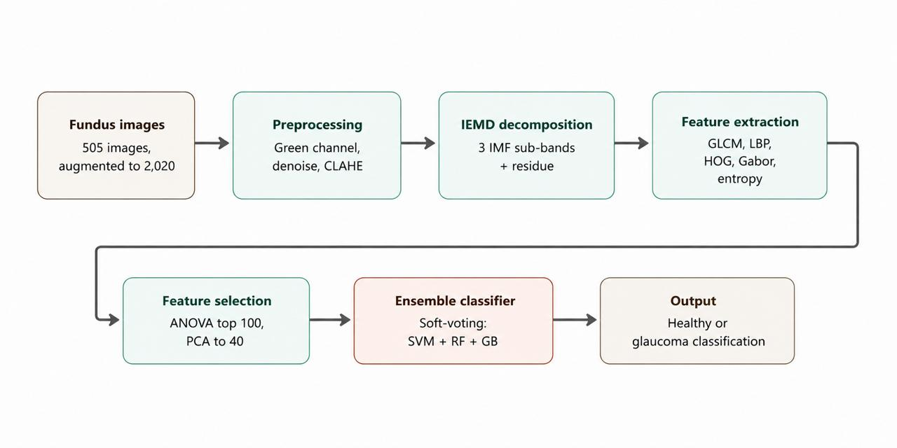
IECS 2026
Methodology
Fig. 1 : Complete processing pipeline for glaucoma classification.
VIT BHOPAL UNIVERSITY, INDIA

Slide 6
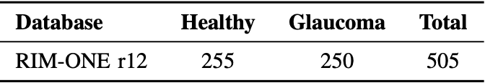
IECS 2026
Dataset- (RIM-One r12)
Source: fundus photographs collected at Spanish ophthalmology centers by the Medical Image Analysis Group (MIAG)
RIM-ONE r12 merges Release 1 + Release 2 into a single combined dataset
Total: 505 images → 255 healthy, 250 glaucomatous
Format: 24-bit JPEG images, at various spatial resolutions
Pre-partitioned folders were combined into one unified dataset of 505 images
Table 1 : Class Distribution in RIM-ONE R12 Database
VIT BHOPAL UNIVERSITY, INDIA

Slide 7
IECS 2026
Preprocessing
Resize all images to 224×224 pixels (uniform size, independent of original camera)
Extract green channel only — best contrast between vessels/nerve fiber layer and background
Apply fast non-local means denoising (h=10) to remove sensor noise
Apply CLAHE (clip limit 4.0, 8×8 tile grid) to enhance nerve fiber and peripapillary visibility
Apply unsharp masking to sharpen optic disc edges
Output: single-channel enhanced image ready for decomposition
VIT BHOPAL UNIVERSITY, INDIA

Slide 8

IECS 2026
Image Empirical Mode Decomposition (IEMD)
Extends 1D Empirical Mode Decomposition to 2D using Hilbert-Huang transform
Decomposes image into Intrinsic Mode Functions (IMFs) + a residue — fully data-adaptive, no fixed basis [5]
Each preprocessed image → 3 IMF layers + 1 residue
Uses a Gaussian pyramid instead of thin-plate splines for the envelope (computational efficiency)
Captures progressively lower spatial frequencies per IMF; residue keeps overall illumination
VIT BHOPAL UNIVERSITY, INDIA

Slide 9
IECS 2026
Multi-Source Feature Extraction
Extracted from 5 sources per image: 3 IEMD sub-bands + full preprocessed image + optic disc crop (80×80)
GLCM texture: 3 distances × 4 directions → mean/SD of energy, contrast, homogeneity, correlation, dissimilarity
Entropy measures: Shannon, Renyi, Kapur, Yager — 4 features per source
Total: 504 features per image
Some of the research work only Gabor transform descriptors — a single feature family [13]. Our pipeline combines 5 feature families (GLCM, entropy, LBP, HOG, Gabor) across 5 sources — far richer texture/frequency/spatial representation.
VIT BHOPAL UNIVERSITY, INDIA

Slide 10
IECS 2026
Feature Selection & Dimensionality Reduction
All 504 extracted features were normalized using Z-score normalization to achieve zero mean and unit variance.
One-way ANOVA F-statistic was computed for each feature to measure its importance.
Top 100 most discriminative features were selected, while low-variance and class-insensitive features were removed.
Principal Component Analysis (PCA) was applied to the selected features. [5]
PCA reduced the feature space from 100 features to 40 principal components.
The 40 principal components retained more than 90% of the total variance, reducing feature dimensionality before classification.
VIT BHOPAL UNIVERSITY, INDIA

Slide 11
IECS 2026
Ensemble Classification
Three base classifiers trained on the 40-dimensional PCA feature space:
SVM — RBF kernel, class-balanced weights, grid search over C ∈ {10,50,100,200}, γ ∈ {scale, 0.01, 0.001}
Random Forest — 300 trees, max depth 20, min samples split 3, balanced class weighting
Gradient Boosting — 150 estimators, learning rate 0.08, max depth 5, subsample ratio 0.8
Combined via soft voting — predicted class probabilities averaged across all 3 classifiers before final label assignment
Nested (inner) cross-validation used for hyperparameter tuning to prevent data leakage
VIT BHOPAL UNIVERSITY, INDIA

Slide 12
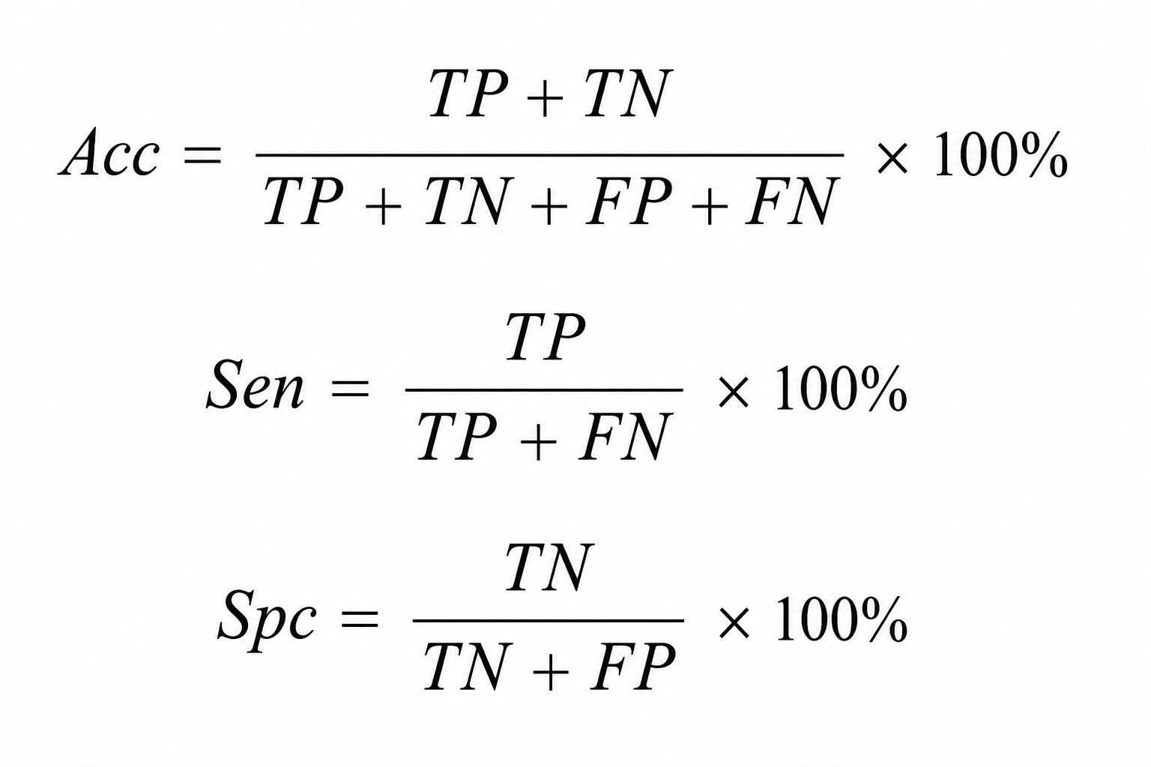
IECS 2026
Evaluation Metrics
Performance Evaluation
Model performance was evaluated using Accuracy, Sensitivity, and Specificity under 10-fold stratified cross-validation.
Performance Metrics
Accuracy: Overall classification performance.
Sensitivity: Correct identification of glaucoma cases.
Specificity: Correct identification of healthy cases.
VIT BHOPAL UNIVERSITY, INDIA

Slide 13
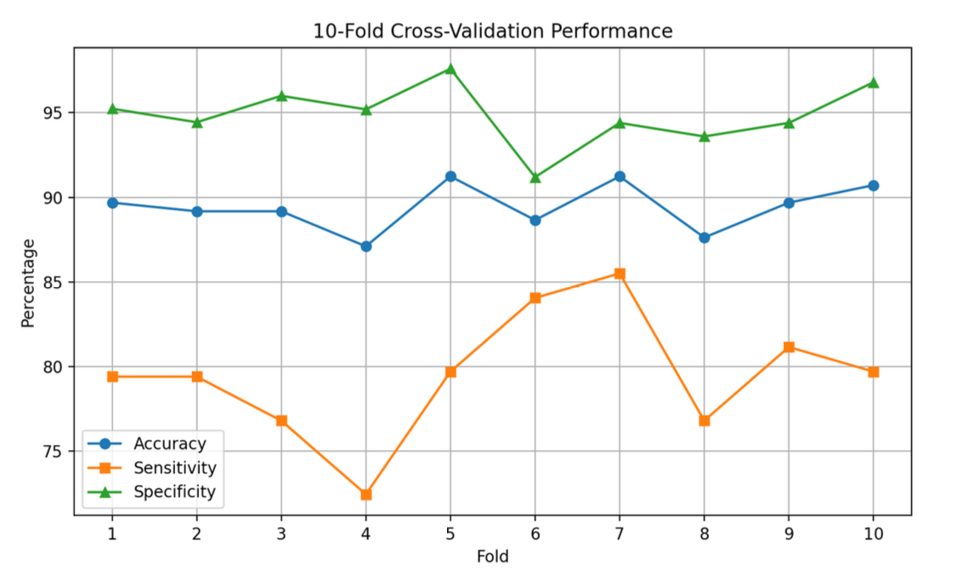
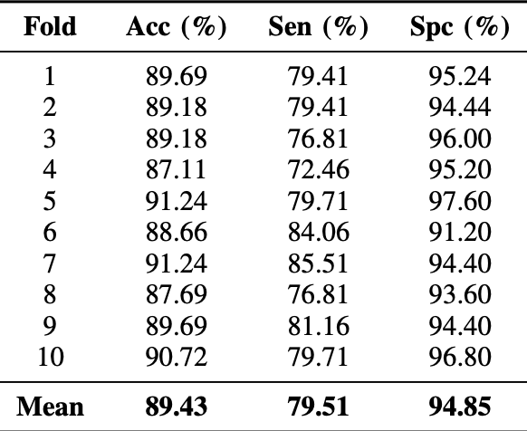
IECS 2026
Results
Table 2 : 10-Fold Cross-Validation Results
Fig. 2 : Performance of the proposed ensemble model across the 10-fold cross validation on the RIM-ONE r12 binary dataset.
VIT BHOPAL UNIVERSITY, INDIA

Slide 14
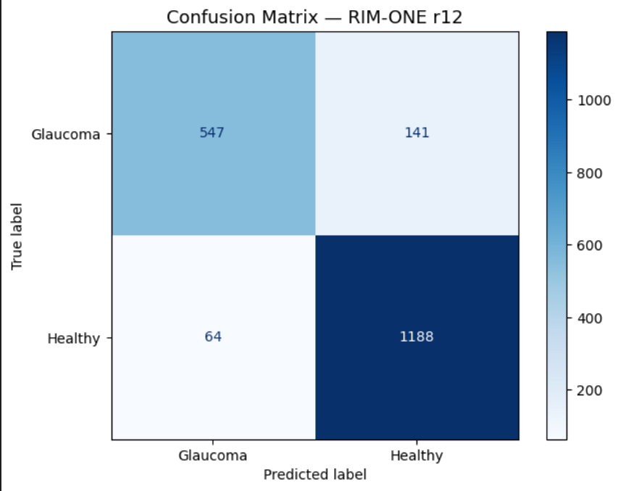
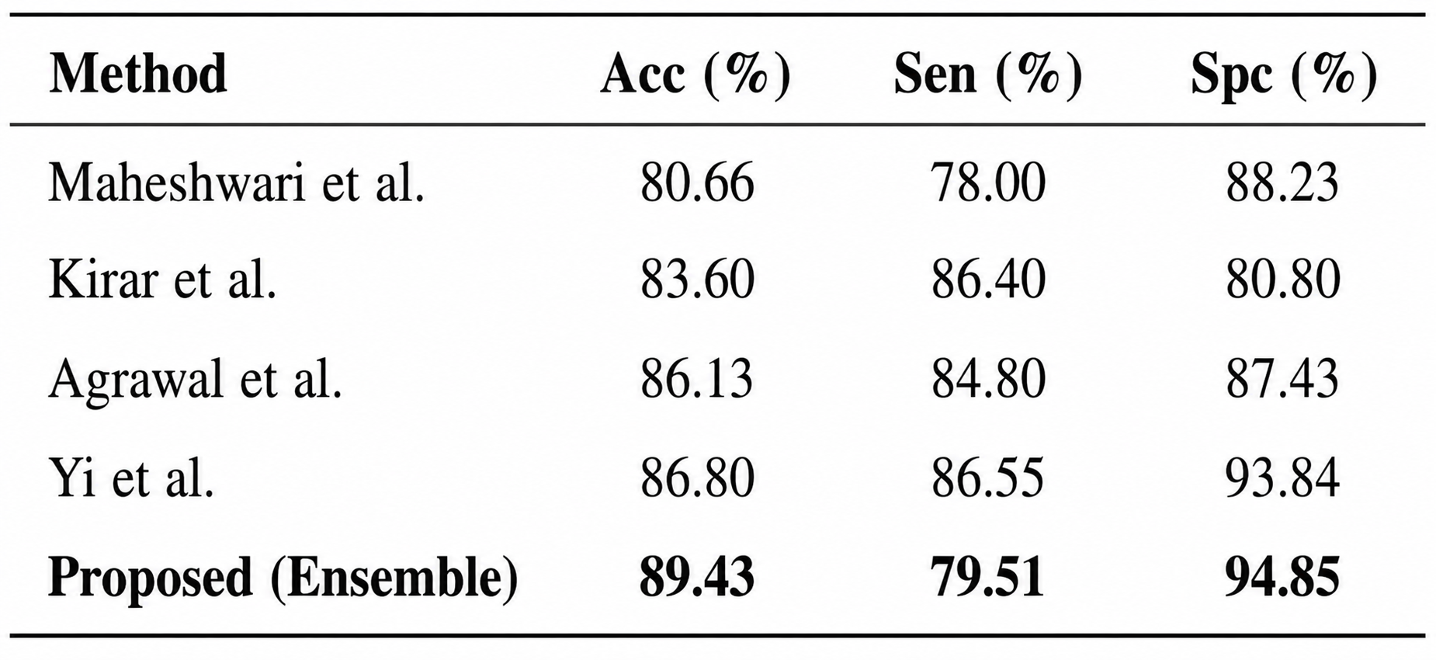
IECS 2026
Comparative Analysis
Table 3 : Comparison with State-of-the-Art Methods
Key Findings
Proposed ensemble achieved the highest accuracy (89.43%).
High specificity (94.85%) indicates reliable healthy-eye classification.
Confusion matrix shows effective separation between glaucoma and healthy samples.
Fig. 3 : Aggregated confusion matrix obtained from 10-fold stratified cross-validation on the RIM-ONE r12 dataset.
VIT BHOPAL UNIVERSITY, INDIA

Slide 15
IECS 2026
Conclusion
Developed an automated glaucoma detection system using retinal fundus images.
Combined IEMD, handcrafted features, ANOVA, and PCA for robust feature extraction and selection.
Achieved 89.43% Accuracy, 79.51% Sensitivity, and 94.85% Specificity using an ensemble classifier.
High specificity makes the system suitable for reliable large-scale glaucoma screening.
Future work includes multi-stage glaucoma grading, deep learning integration, and validation on larger clinical datasets.
VIT BHOPAL UNIVERSITY, INDIA

Slide 16
IECS 2026
References
[1] S. Maheshwari, R. B. Pachori, and U. R. Acharya, Automated Diagnosis of Glaucoma Using Empirical Wavelet Transform and Correntropy Features Extracted from Fundus Images, IEEE Journal of Biomedical and Health Informatics, 2017.
[2] B. S. Kirar and D. K. Agrawal, Computer Aided Diagnosis of Glaucoma Using Discrete and Empirical Wavelet Transform from Fundus Images, IET Image Processing, 2019.
[3] D. K. Agrawal, B. S. Kirar, and R. B. Pachori, Automated Glaucoma Detection Using Quasi-Bivariate Mode Decomposition from Fundus Images, IET Image Processing, 2019.
[4] S. Yi, L. Zhou, L. Ma, and D. Shao, MTRA-CNN: A Multi-Scale Transfer Learning Framework for Glaucoma Classification in Retinal Fundus Images, IEEE Access, 2023.
[5] D. Parashar and D. K. Agrawal, Classification of Glaucoma Stages Using Image Empirical Mode Decomposition from Fundus Images, Journal of Digital Imaging, 2022.
[6] A. Linderhed, Image Empirical Mode Decomposition: A New Tool for Image Processing, Advances in Adaptive Data Analysis, 2009.
VIT BHOPAL UNIVERSITY, INDIA

Slide 17
IECS 2026
References
[7] U. R. Acharya et al., Decision Support System for Glaucoma Using Gabor Transformation, Biomedical Signal Processing and Control, 2015.
[8] J. Nayak, U. R. Acharya, P. S. Bhat et al., Automated Diagnosis of Glaucoma Using Digital Fundus Images, Journal of Medical Systems, 2009.
[9] K. P. Noronha, U. R. Acharya, K. Nayak et al., Automated Classification of Glaucoma Stages Using Higher Order Cumulant Features, Biomedical Signal Processing and Control, 2014.
[10] J. Cheng et al., Superpixel Classification Based Optic Disc and Optic Cup Segmentation for Glaucoma Screening, IEEE Transactions on Medical Imaging, 2013.
[11] L. Li et al., A Large-Scale Database and a CNN Model for Attention-Based Glaucoma Detection, IEEE Transactions on Medical Imaging, 2020.
[12] M. C. V. Stella Mary, E. B. Rajsingh, and G. R. Naik, Retinal Fundus Image Analysis for Diagnosis of Glaucoma: A Survey, IEEE Access, vol. 4, pp. 4327–4354, 2016.
VIT BHOPAL UNIVERSITY, INDIA

